Slide 1
Personalized Diet Assistant: Data Collection and Feasibility Analysis to Tailor Nutritional Support
UNCC DSBA 6165 - AI and Deep Learning
Jack Callahan, Owen Althouse, Matthew Rostar, Shlok Yeolekar, Lillian Bowling, Hayden
Williford
Notes:
Jack

Slide 2
Motivation and Purpose
Initial goal was to create a personalized AI-powered dietary assistant that recommends meals, nutritional choices, and a grocery list based on user profiles, health goals, and personal preferences
As the project scope became more refined and narrow, it evolved into exploring image classification convolutional neural networks (CNN) to identify food labels from images of food.
The motivation remains the same. To improve long-term public health and fight obesity by helping users make better decisions about their nutrition.
Notes:
Jack

Slide 3
Project 3 Initial CNNs
MobileNetV2 Model
Training accuracy of 79.15%
Testing accuracy of 74.35%
2 Hidden Layers
128x128 Resolution
ResNet50 Model
Training accuracy of 79.80%
Testing accuracy of 72.09%
2 Hidden Layers
128x128 Resolution
Notes:
Owen

Slide 4
Potential Model Improvements
Learning Rate:
Previous models used a learning rate of 0.001
L2 Weight Regularization:
L2 weight regularization to prevents overfitting by adding a penalty to the model's loss function, proportional to the sum of the squares of its weights (coefficients)
Dropout:
Prevents overfitting by randomly disabling (dropping out) neurons during training
Increase Image Resolution
128x128 increased to model maximum of 224x224
Notes:
Owen

Slide 5
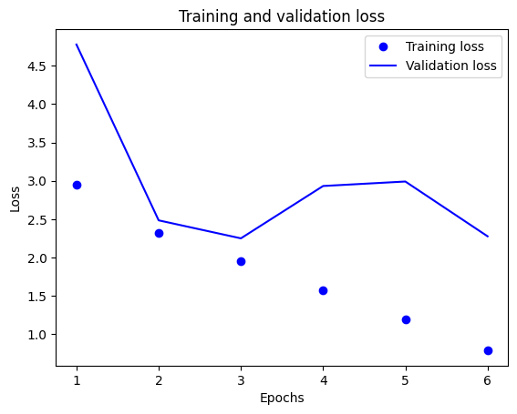
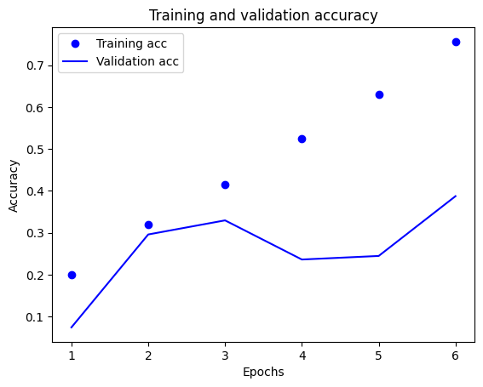
Basic CNN Model
Model contained 19 total layers, including softmax output layer
Learning rate of 0.0005
Dropout of 0.5
Batch Normalization
ReLU activation function
Trained for 10 epochs
Notes:
Matthew

Slide 6
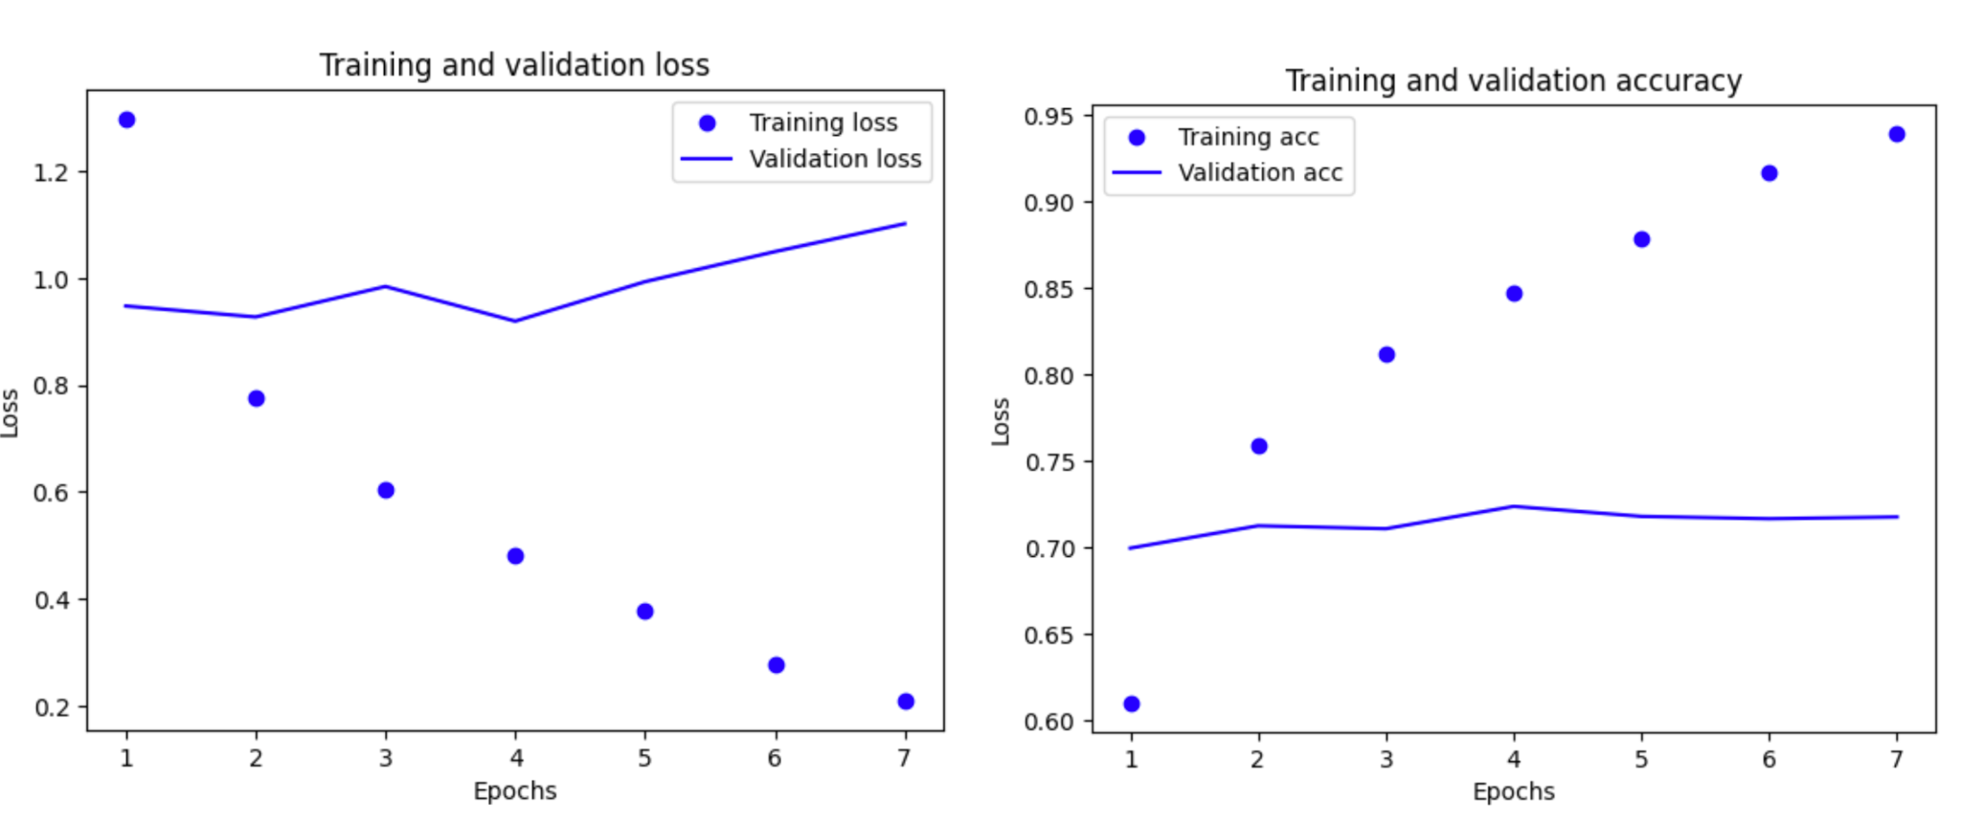
Learning Rate 0.001 → 0.0005
Testing Dataset accuracy of 72.97%
Training was ~95% showing signs of high memorization
Lowering the learning rate did not improve generalization
4th epoch was when model performed the best on validation data
Notes:
Matthew

Slide 7
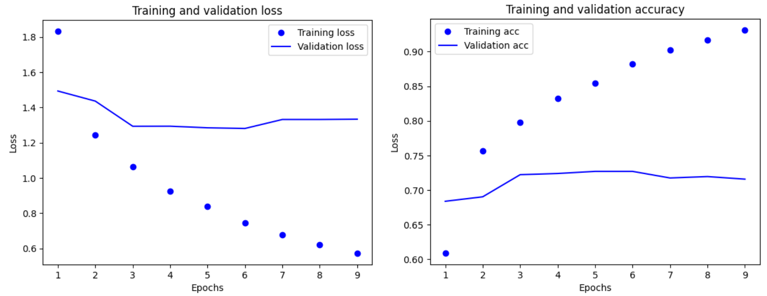
Weight Regularization
L2 Weight Regularization, LR 0.0005
Test accuracy: 73.28%
Encourages smoother, simpler models
Applied using Kernel Regularizer in both hidden layers of MobileNetV2 fine-tuning
Validation loss did not drop below 1.25 which is worse than model without L2 regularization
Notes:
Hayden

Slide 8
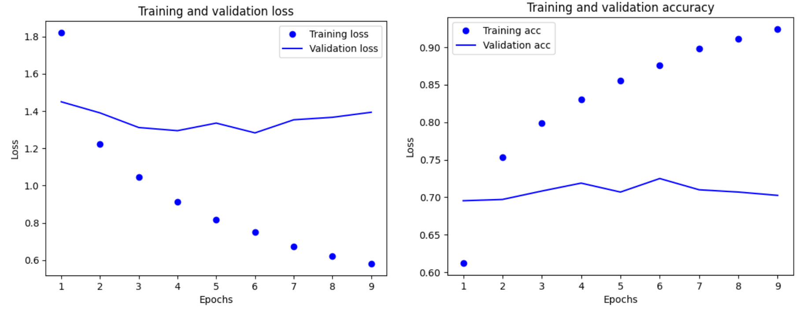
Weight Regularization
L2 Weight Regularization, LR 0.001
Test accuracy: 73.66%
Trained for 9 epochs
Increasing the learning rate only had minimal increase on accuracy
Validation loss had little improvement and validation accuracy never improved during training
Notes:
Hayden

Slide 9
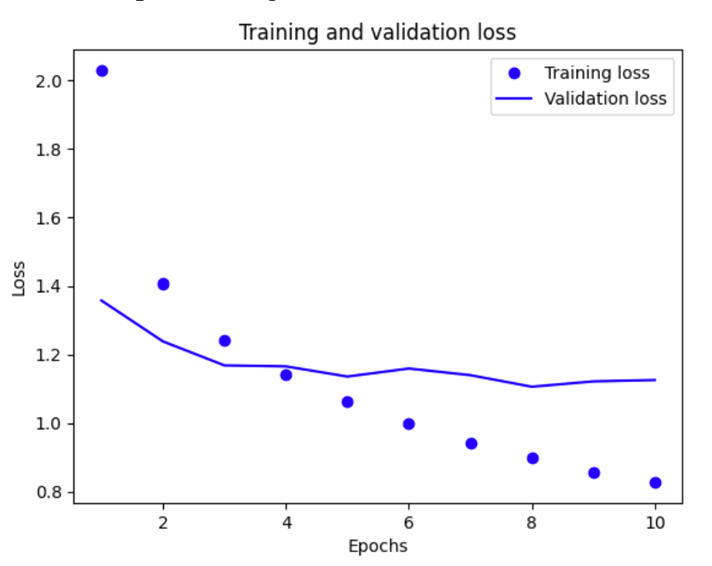
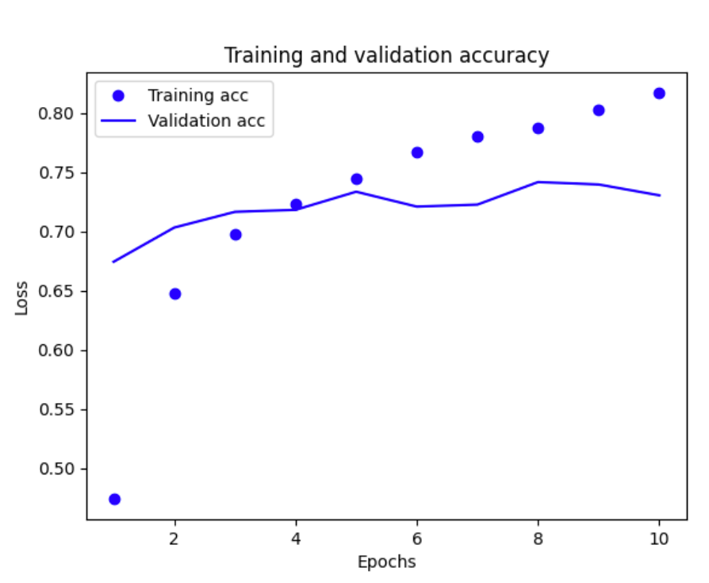
Dropout
50% Dropout Rate.
Model trained for all 10 epochs
Continuous Improvement
Test accuracy: 74.23%
Equivalent to Baseline Model at 128x128 Resolution
Training and validation loss improved moderately every epoch
Training accuracy peaks at ~80%
15% less than other models
Notes:
Hayden

Slide 10
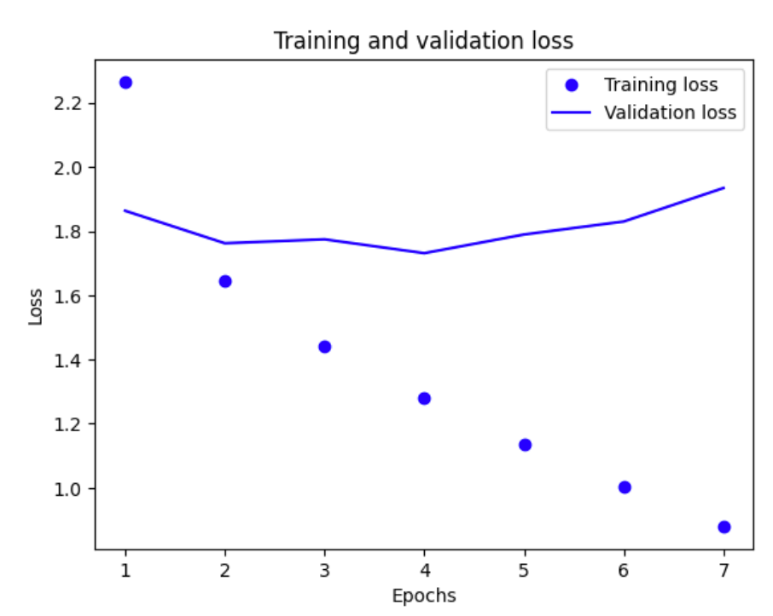
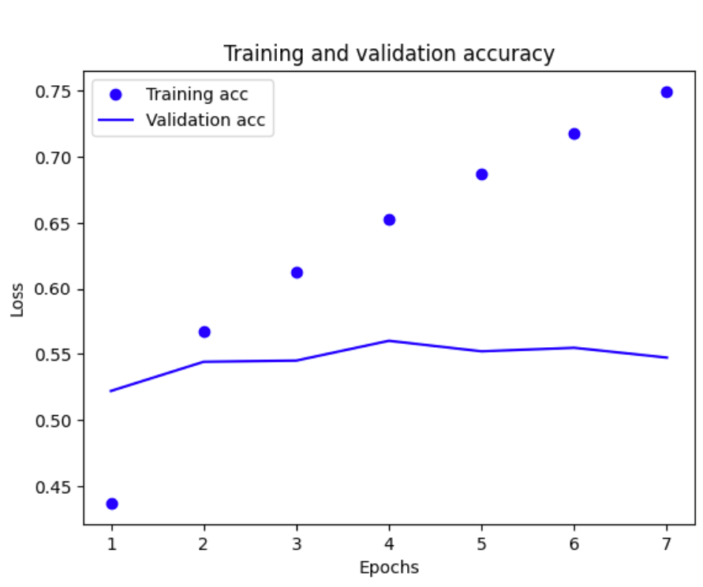
Complete 101 Output Model
Model tested at original settings
Testing accuracy of 56.14%
Recommended accuracy of 82.74%
Notes:
Shlok
In order to check if there was any setup or augmentations that were limiting our model performance we decided to run the model with the exact same settings as the original article did with all 101 output classes. Since the article claimed an accuracy of over 82% we wanted to see if we could at least match that. Unfortunately our runs resulted in an accuracy of 56.14% so we decided to just stick with the CNNs that we had trained with our own settings.

Slide 11

LLM Image Classification
Gemini 2.5 Flash-Lite
Same testing dataset and labels
Testing accuracy of 98%
Accuracy was worse without labels.
Most Common Guess: “Plate”
Notes:
Shlok

Slide 12
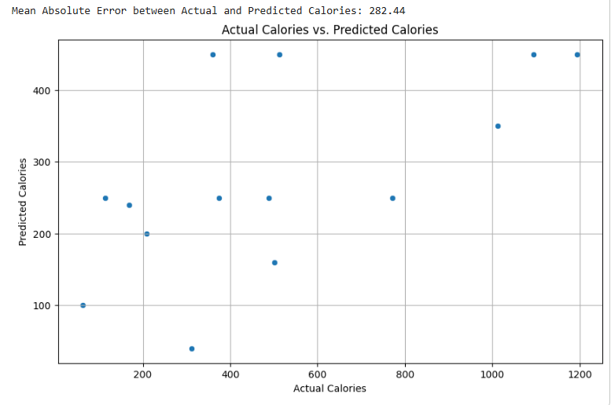
LLM Nutrition Information Estimation
Expected Prediction
Notes:
Shlok
24 before rate limit issues,

Slide 13
Results
Dropout increased model performance the most
Longer training could have additional improvement
Techniques used combat overfitting
Baseline model was not extremely overfit
Lower end LLM models performed better than all models when classifying
Not locally run, costs involved
LLM consistently underestimated nutritional information
Image source site crashed during training
Notes:
Lilly

Slide 14
Lessons Learned
- Time/compute required to train CNN Models
- Data augmentation and more fine-tuning layers
- Remove early stopping or increase patience
- AI is good at classification, poor at estimation
- Image Resolution improvement might not be worth the resources
Notes:
Lilly

Slide 15
Conclusion
Hyperparameter tuning does not guarantee improvements in performance.
Hyperparameter tuning is a very resource demanding process. Are the hours spent tuning and training the model worth minimal gains in performance?
Noise in real world images will limit accurate classification. Impossible to solve this completely.
All fine-tuning hyperparameter techniques have practical use case where improvements can effect model performance
Notes:
Lilly

Slide 16
References
[1]. Samuel D. Emmerich, D.V.M., Cheryl D. Fryar, M.S.P.H., Bryan Stierman, M.D., M.P.H., and Cynthia L. Ogden, Ph.D., M.R.P. Centers for Disease Control and Prevention. Obesity and severe obesity prevalence in adults: United States, August 2021–August 2023 [Internet]. CDC.gov. CDC; 2024 [cited 2025 Sep 14]. Available from: https://www.cdc.gov/nchs/products/databriefs/db508.htm
[2]. Charlotte, NC - Metric Detail | City health dashboard [Internet]. Cityhealthdashboard.com. 2025 [cited 2025 Sep 14]. Available from: https://www.cityhealthdashboard.com/NC/Charlotte/metric-detail?metricId=17&dataPeriod=2022
[3]. AI food scanner turns phone photos into nutritional analysis | NYU Tandon School of Engineering [Internet]. Nyu.edu. 2025 [cited 2025 Sep 14]. Available from: https://engineering.nyu.edu/news/ai-food-scanner-turns-phone-photos-nutritional-analysis
[4]. ​​Alessio A, Alessia R, Bianchetti G, Serantoni C, De Spirito M, Stefano C, et al. Digital applications for diet monitoring, planning, and precision nutrition for citizens and professionals: a state of the art. Nutrition reviews. 2024 [cited 2025 Sep 14]. Available from: https://academic.oup.com/nutritionreviews/article/83/2/e574/7667651
[5]. Foodvisor App | Calorie counter - eat healthy & lose weight [Internet]. foodvisor.io. 2025 [cited 2025 Sep 14]. Available from: https://www.foodvisor.io/en/
[6]. Food image recognition explained [Internet]. Foodvisor. 2025 [cited 2025 Sep 14]. Available from: https://www.foodvisor.io/en/guides/article/food-image-recognition-explained/
‌
[7]. Cal AI [Internet]. Calai.app. 2024 [cited 2025 Sep 14]. Available from: https://www.calai.app/
‌
[8]. Bort J. Photo calorie app Cal AI, downloaded over a million times, was built by two teenagers | TechCrunch [Internet]. TechCrunch. 2025 [cited 2025 Sep 14]. Available from: https://techcrunch.com/2025/03/16/photo-calorie-app-cal-ai-downloaded-over-a-million-times-was-built-by-two-teenagers/
[9]. Tahir G, Loo CK. A comprehensive survey of image-based food recognition and volume estimation methods for dietary assessment [Internet]. arXiv.org. 2021 [cited 2025 Sep 14]. Available from: https://arxiv.org/abs/2106.11776
[10]. Ghosh T, Sazonov E. Improving food image recognition with noisy vision transformer [Internet]. arXiv.org. 2025 [cited 2025 Sep 14]. Available from: https://arxiv.org/abs/2503.18997
[11]. Yash Paliwal. Understanding retrieval-augmented generation (RAG) in generative AI: An Overview [Internet]. Medium. 2024 [cited 2025 Sep 15]. Available from: https://medium.com/@yashpaliwal42/understanding-retrieval-augmented-generation-rag-in-generative-ai-an-overview-914ef820d0f0

